Slide 1
Digital Design and Computer Architecture
Course outcome 1

Slide 2
PROJECT TITLE
DIGITAL DOOR ACCESS SYSTEM USING COMBINATIONAL LOGICS

Slide 3
Presented by
1.Sai Hitesh – 2620030269
2. Hyder – 2620030257
3. Radhika – 2620030258
4. Akshith - 2620030282

Slide 4
Objectives
The main objective of the Digital Door Access System Using Combinational Logic project is to design and simulate a secure digital door-lock system using logic gates. The system verifies a 4-bit password entered by the user and allows access only when the entered password matches the predefined password.
Specific objectives:
To understand the application of combinational logic circuits.
To design a password verification circuit using AND and NOT gates.
To provide access only for the correct password .
To simulate and verify the circuit using Logisim.
To demonstrate the use of digital logic in basic security systems

Slide 5
Logic Design
The Digital Door Access System is designed using combinational logicgates. For a 4-bit password 1011, the inputs are compared with thepredefined password.
The required logic is: AB'CD
Where:
A = 1
B = 0
C = 1
D = 1
Access = 1 → Door Open
For any other combination, Access = 0 → Door Closed

Slide 6
Logic gates used:
NOT Gate – converts B = 0 into 1.
AND Gate – checks whether all required inputs match the password.
LED/Output – indicates whether access is granted.

Slide 7
What are the input components and Output Description?
Input Component | Output Description
A, B, C, D | 4-bit password inputs
P₀, P₁, P₂, P₃ | Predefined password bits
AND gates | Check whether each bit matches
NOT gates | Produce complement of input bits
Final AND gate | Confirms all bits are correct
Unlock | Door opening signal

Slide 8
Working
The user enters a 4-bit password using switches.
NOT gates generate the required complemented inputs.
AND gates check whether the entered bits match the predefined password.
The outputs are combined using an AND gate.
If all four conditions are satisfied, Unlock = 1.
Otherwise, Unlock = 0, and the door remains locked.

Slide 9
Simulation
The circuit can be simulated in Logisim using:
4 Input Pins/Switches
NOT gates
AND gates
LED for Door Unlock
Optional LED for Door Locked

Slide 10
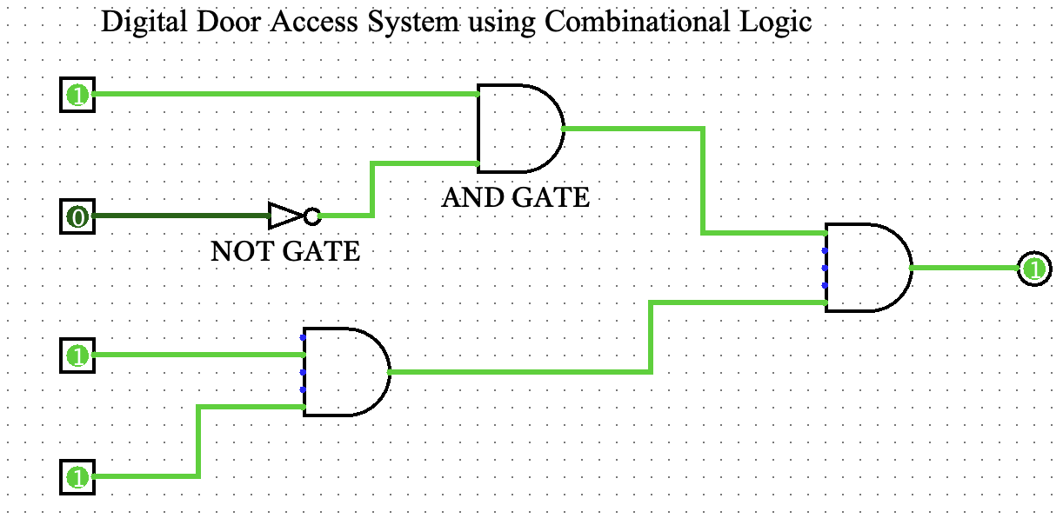

Slide 11
Truth table
A | B | C | D | X
0 | 0 | 0 | 0 | 0
0 | 0 | 0 | 1 | 0
0 | 0 | 1 | 0 | 0
0 | 0 | 1 | 1 | 0
0 | 1 | 0 | 0 | 0
0 | 1 | 0 | 1 | 0
0 | 1 | 1 | 0 | 0
0 | 1 | 1 | 1 | 0
1 | 0 | 0 | 0 | 0
1 | 0 | 0 | 1 | 0
1 | 0 | 1 | 0 | 0
1 | 0 | 1 | 1 | 1
1 | 1 | 0 | 0 | 0
1 | 1 | 0 | 1 | 0
1 | 1 | 1 | 0 | 0
1 | 1 | 1 | 1 | 0

Slide 12
Expected Result
The Unlock LED glows only when the correct password (1011) is entered.

Slide 13
THANK YOU

